Slide 1
Knowledge Base
Introduction
Knowledgebase is an intranet based system that is designed to allow users to enter state/county specific comments and values.
A user friendly web based UI was developed to provide Maximum data/values entry screens with Drop Down Controls to the master data .
A very powerful Search engine has been provided for the flexible search criteria’s on the state/count specific comments and values like issue type, issue details ,issue resolution etc.
Search page supports wildcard search on the issue details and resolution.

Slide 2
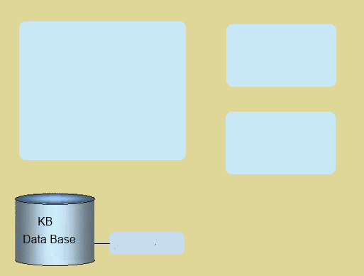
Knowledge Base
High Level Architecture
IIS
HTTP
Fast Pass Authentication
Client Web browser
ASP.NET
Knowledge Base Intranet site
ASP.NET
User interface
Business Layer
HTTP
Data Access Layer
Client Web browser
stored procedure

Slide 3
Knowledge Base
Technology Stack
Web hosting
IIS
APS.Net 3.5
Development
visual studio 2008
Client Side
Html
JavaScript's
Ajax
APS.Net 3.5
Ajax Tool Kit
SQL Server 2008

Slide 4
Knowledge Base
Thank You

